Slide 1

Computer Networks:

Slide 2
1. What is Computer Networks?
Computer Networks is nothing but many computers that connected together is called Computer Networks.
2. What is Internet?
It is nothing but the Collection of Computer networks is known as Internet.
3. Define Protocol?
Protocol is like a set of rules that is being used for sharing different types of Data between computer’s.
Example: TCP,UDP.

Slide 3
Why do we need Protocol?
Let’s say one country has an application that communicates with different rules and other country may go with different rules so to avoid these kind of things we need protocols and Internet Society is responsible for these things.
How Data is Transferred? The sender doesn’t transfers data in one single go, it sends as packets. Packet is nothing but a collection of small amount of data.

Slide 4
IP Address: - Internet Protocol. Basically, the Computers and Servers are identified by IP address only. - Format: X.X.X.X (Every single X has some number between 0 to 255). - To check own computers IP use curl command, $curl ifconfig.me -s .
Internet Service Provider It will have Global IP address and the Network Device’s like Modem/Router will assign IP’s to there connected device with the help of DHCP (Dynamic Host Configuration Protocol) and the NAT (Network
Access Transfer) will identifies which device to send the data. Note: Global IP address is nothing but if we request Google and there server will know this request is made from this IP(our ISP) not our Computer’s IP.

Slide 5
Port Number:
- It is used to identifies the application which is requested from the device.
- Basically a 16 bit number each contains 0’s and 1’s.
- Totally there are 65536 ports in that 0–1023 are reserved, 1024 -49152 are registered for applications like MySQL, MongoDB and we can use the rest for our use.
Note: Port Number 80 is used to identifies the application which is requested.

Slide 6
How are the Computer’s connected? In Guided and Unguided way(Wired & Wireless respectively). Wired uses Twisted Pair Cable, Coxial Cable and Fibre Opticable whereas Wireless are Radiowaves and Microwaves. Wired are faster than Satellites and Wireless are used for lower range like Bluetooth, Wifi etc. Types of Network’s: LAN — Local Area Network (used in houses/offices like Wifi and Ethernet), MAN — MetroPolitan Area Network (across Cities), WAN — Wide Area Network (across Countries by FibreOptical Cables).

Slide 7
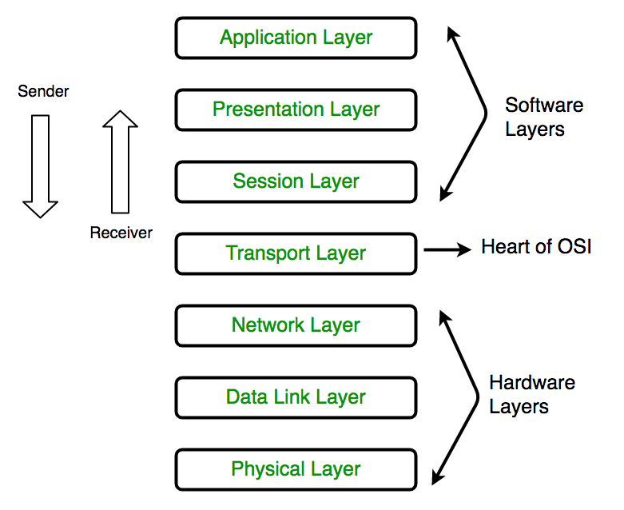
Structure of the Network:
Basically the Network’s structure is based on the OSI Model(Open System Interconnection Model) and this is how the Internet works and this is the standard way for 2 or more computers communicate with each other.

Slide 8
Ephemeral Ports: Now there might be a chance of multiple tabs opened in Chrome (Application), so in this case it uses Ephemeral Ports, it exists on Client Side. When client requested internally the server will use ephemeral ports. Error/Status Code: When we request to the server, we want to know that whether the request is successful or not, for this it is used.
Cookies: These are called Unique String, files that is stored in my Browser. Server will know that who is contacting and cookies has expiration date also. ThirdParty Cookies: It is nothing but cookies are set for the URL that we not visited.

Slide 9
How Email Works: Email stands for Electronic Mail. For sending email, it uses SMTP and for receiving email it uses POP3(downloading) or something like IMAP(getting mails). Email uses TCP for transferring. DNS: It is nothing but Domain name System. Simple example is Every civilians has there own ID proof like that every domain has its own IP address.

Slide 10
Network Commands:
$ hostname -> Displays the name of the localhost kali.
$ nslookup google.com -> Checks the IP for particular domain.
$ ping google.com -> It connects with the server & starts receiving packets.
$ hostname -i - To check the IP for the localhost

Slide 11
5. $.dig -v -> It gives information about Domain Name Servers.
6. $ netstat -> Listening to the ports that are active.
7. $ whois google.com -> It displays the entire information of the domain.
$ ip route get “domain address” - It displays the source and destination address.

